Slide 1
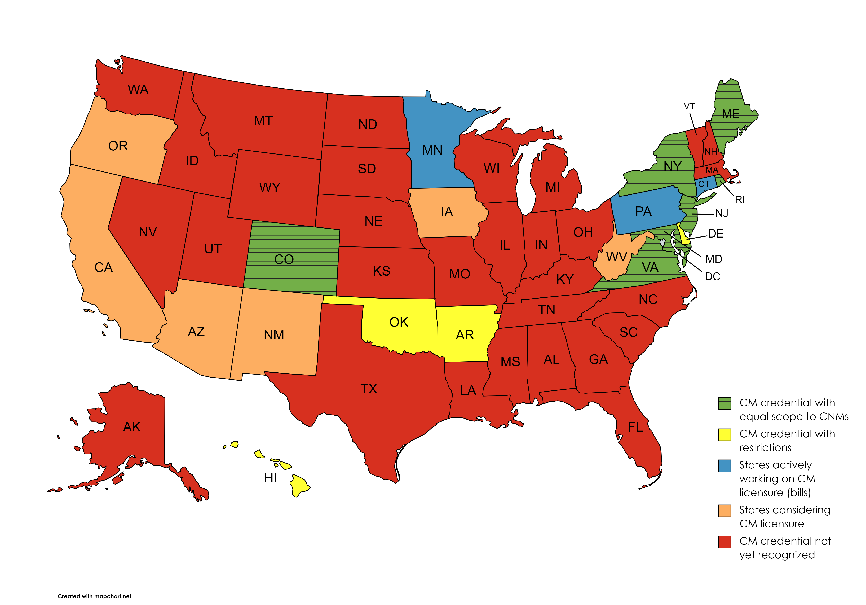
Practice Environment for Certified Midwives – July 2023

