Slide 1
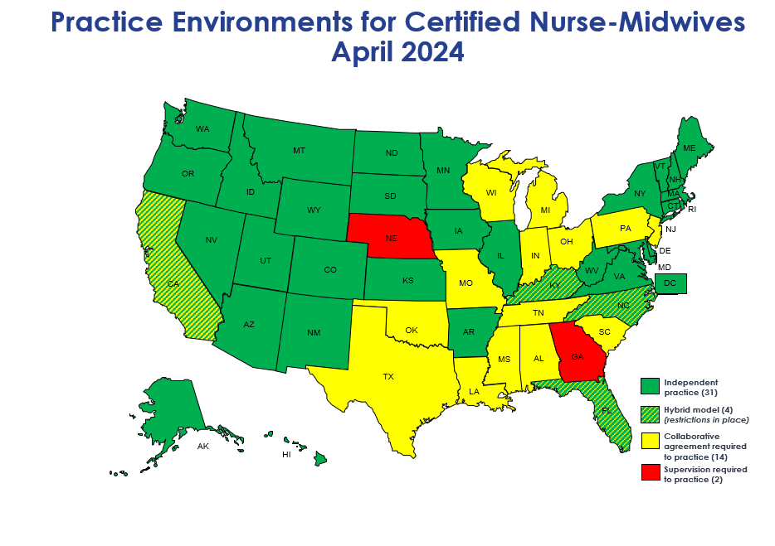
Notes:
Light green: all different regs, but CNMs can apply for privileges
Green: full practice authority, but no guarantee of privileges
Hybrid model (CA, FL, KY, NC): removed the requirement for physician "supervision" in certain situations
CPA required (yellow)
GA needs physician "supervision" for rx authority
NE and OK need physician "supervision" for practice

Slide 2
Practice Environments for Certified Midwives - April 2024
WA
MT
ND
ME
OR
MN
VT
NH
ID
SD
WI
NY
MA
WY
MI
CT
RI
NV
NE
IA
PA
NJ
OH
DE
UT
IL
IN
CO
WV
VA
MD
CA
KS
MO
KY
DC
TN
NC
AZ
NM
OK
AR
SC
CM credential with FPA (6) MD, ME, NY, RI, VA & DC
MS
AL
GA
CM credential with restrictions (5) AK, DE, HI, NJ, OK
TX
LA
CM credential not yet recognized (41)
FL
States considering
CM legislation (6)
AK
HI

