Slide 1
Six Microskills for Clinical Teaching
Get a commitment
Probe for supporting evidence, then
Teach general principles
Reinforce what was done right
Correct mistakes
Identify next learning steps

Slide 2
Microskill 1: Get a Commitment
The learner is encouraged to make a commitment to a diagnosis, work-up, or plan.
When learner presents facts and then stops; resist the urge to fill in the blanks.
Student:
“I just finished examining a 16 year-old girl. She has been complaining of pain when she urinates for the past few days. She has never had a urinary tract infection. She denies burning on urination, abdominal pain, fever or seeing blood in her urine. She says she thinks her last menstrual period was a couple of weeks ago. I don’t know if she is sexually active. I wasn’t sure if I was supposed to ask those kinds of questions. She is here with her mother.”

Slide 3
Microskill 2: Probe for Supporting Evidence
Student:
“On physical exam, she looked well to me. She was afebrile and the rest of her vital signs were O.K. Her HEENT exam was normal. Her lungs were clear and her heart was regular without any murmurs. Her abdomen was soft and not tender and I didn’t think her spleen or liver were enlarged. That’s all I examined.”
Help the learner reflect upon the mental processes used to arrive at the decision.
Identify what the learner does and does not know.
The learner commits to a stance and looks to the teacher for confirmation: suppress the urge to pass judgment.

Slide 4
Microskill 2: Sample Questions
Examples
“What were the main findings that led to your diagnosis?”
“I’m interested in understanding how you have come to this conclusion.”
“Why did you choose that medication given the availability of others?”
Not
“Name the 6 most likely causes of _______?”
“Don’t you have any other ideas?”

Slide 5
Microskill 3: Teach General Principles
Keep it to 1-3 general rules at most.
Keep information general, avoiding anecdotes and idiosyncratic preferences
The teacher can skip this step when appropriate.
Preceptor:
“The UTI is a logical possibility but we don’t have adequate information to confirm the diagnosis. We need a more complete physical examination -- particularly of the lower abdomen and external genitalia. We also need a sexual history. Has she suddenly become sexually active?”

Slide 6
Microskill 3:Examples
Examples
“Typically there are two main treatment options.”
“Important factors to consider are . . .”
Not
“I’ve always done it that way.”
“This patient needs Lasix.”

Slide 7
Microskill 4: Reinforce What Was Done Right
Competencies must be repeatedly rewarded and reinforced.
Build upon the learner’s professional self-esteem.
Focus on specific behaviors.
Preceptor:
"You identified the most probable concern in this case but you need to complete the physical exam and get a sexual history. Without more information, we can’t be sure of what we have. Do you want me to model how to take a sexual history and do a pelvic examination or would you like me to observe you do them?”

Slide 8
Microskills 4: Examples
Examples
“You did a really good job of prioritizing that patient’s long list of problems at today’s visit.”
You were conscious of the patient’s financial situation and cost in selecting the most appropriate antibiotic. This will help the patient be compliant with medication.
Not
“Good job!”

Slide 9
Microskill 5: Correct Mistakes
An appropriate time and place must be chosen.
Ask the learner to critique their own performance first.
Focus on how to correct the problem or avoid it in the future.

Slide 10
Microskills 5: Examples
Example
“You may be right that this child’s symptoms are due to a URI. But without checking the ears, you may be overlooking an otitis media.”
“There are more cost-effective approaches to treating ___________.”
Not
“Why don’t you read about that later.”
“That whole case was handled badly.”

Slide 11
Microskill 6: Identify Next Learning Steps
Fosters self-directed learning; facilitates the learner identifying their own needs.
Offer specific resources as appropriate; the idea is for the teacher to role model their own learning approaches.
Agree upon an action plan

Slide 12
Microskill 6: Examples
What do you think you need to learn more about?
That’s a good topic to research. I tend to use ___________ as a first step in looking up this type of information.
Let’s agree to discuss this again on Friday after you have had time to research this.

Slide 13
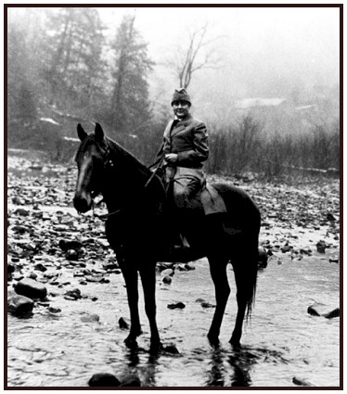
Frontier School of Midwifery and Family Nursing

